Slide 1

SAFe for Teams Scaled Agile Framework® (SAFe®) 4.5
V4.5.0

Slide 2
Agenda : Learning Objectives
Introducing the Scaled Agile Framework
Building an Agile Team
Planning the Iteration
Executing the Iteration
Executing the PI
SAFe 4.5 Big Picture

Slide 3
Lesson 1 Introducing the Scaled Agile Framework
V4.5.0

Slide 4
Learning Objectives
1.1 Connect with the Scaled Agile Framework
1.2 Explore Lean, the Agile Manifesto and SAFe Principles
1.3 Identify Scrum, Kanban and XP Practices

Slide 5
1.1 Connect with the Scaled Agile Framework
Notes:
First, let's discuss embracing a Lean-Agile mindset.

Slide 6
How do we keep pace?
Our development methods must keep pace with an increasingly complex world
We’ve had Moore’s Law for hardware, and now software is
eating the world
Our development practices haven’t kept pace; Agile shows
the greatest promise, but was developed for small teams
We need a new approach, one that harnesses the power of
Agile and Lean, and applies to the needs of the enterprises
who build the world’s most important software and systems.
2011
Now…
Notes:
The Framework is based on a set of disparate but compatible bodies of knowledge – Agile development, Lean thinking and Lean product development, systems thinking, and systems engineering.
The knowledge of the Framework isn’t a one-time learning event…. It’s an ongoing process.
The first public release of SAFe, in its current web-accessible form, was in 2011. But its history goes back even earlier than that. So you can see that the pace of innovation is relentless and constant; we are always updating the site and its corresponding courseware with what we learn.
Articles can be updated and republished at any time. Previously we’d release more frequent updates to the “Big Picture” itself, but now there is about a once-a-year release cycle on the BP. We make an effort to be backwards compatible wherever possible, so the specific practices and roles you’ve adopted can remain largely unchanged while you avail yourself of the new features in each new release. “Behind the BP,” the pace of innovation continues, as we are continuously updating new articles and adding guidance articles as well.
With SAFe 4.0, we have merged the practices of SAFe for Lean Systems Engineering and SAFe 3.0 into a new release. As such, SAFe 4.0 handles the needs of small to medium-size software and systems builders, but it also scales to the needs of those building some of the world’s biggest, most complex, and most impactful software solutions and cyber-physical systems.
Let’s look further into this major new release.

Slide 7

We thought we’d be developing like this.
Notes:
I’m guessing for most of us, 20 or 30 years ago, we didn't think developing would be like this.
We thought we'd be developing at massively powerful workstations—which we are ...
… using third-generation, fourth-generation, fifth-generation languages—which we largely have …
… and creating a wireframe, and dragging and dropping a class library, and coding some business logic and some scripting engines, and jamming that all together and having an application.
But it hasn't really turned out that way at all….

Slide 8
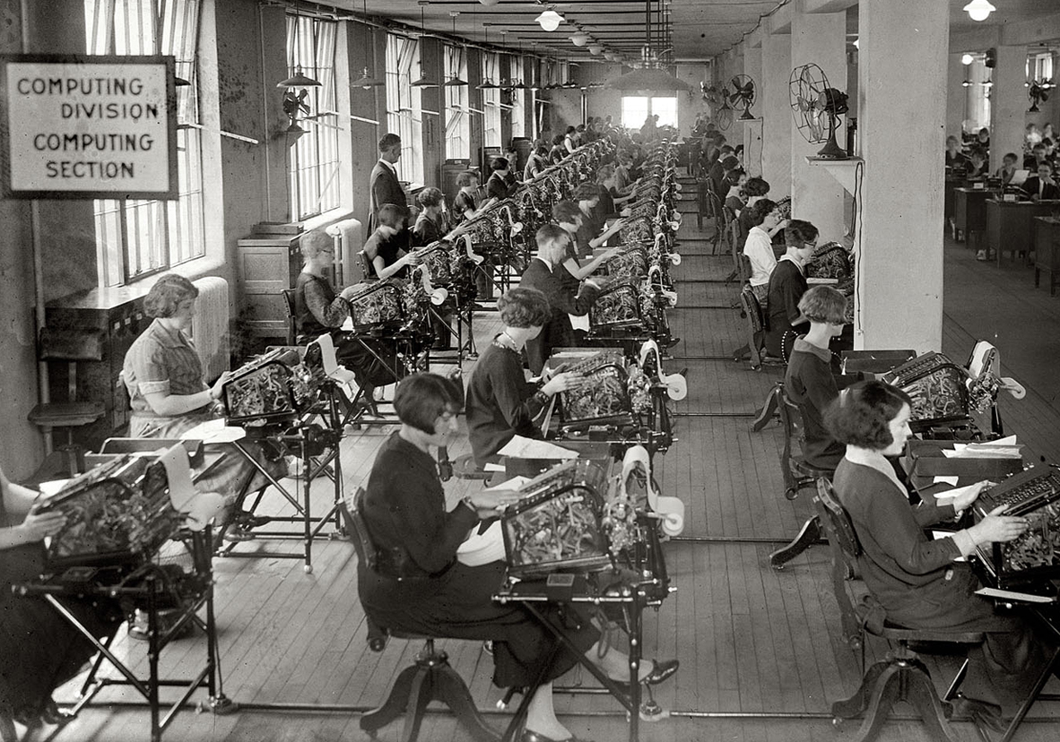
But sometimes it feels like this.
Library of Congress
Notes:
For many of us, it sometimes feels more like this.
Dean Leffingwell, tells a story of when he used this slide in a presentation. He explained the intent was mostly just for fun—and to make the point about how incredibly manually intensive it still is to develop systems of this type, with literally millions of lines of handcrafted code.
Somebody in the back of the room then shouted, "Hey, at least they're collocated!”
While humorous, it drew attention to the power and value of collocation in development, and Agile development in particular….
At least these people can get up, walk to the water cooler, and have a conversation. They can pair, they can shout over their shoulders and say, "What do you think about this?" Many don't have that luxury.

Slide 9
And our retrospectives read like this:
Late
delivery
Too little visibility
Problems discovered too late
Too early commitment to a design that didn’t work
No way to improve systematically
Phase gate SDLC isn't helping reduce risk
Massive growth in complexity
Under-estimated dependencies
Hard to manage distributed teams
Poor morale
Notes:
One of the results, especially as we build systems that are larger and more complex, is that our retrospectives are still troublesome. And that means our results are still troublesome.
Sometimes they look like this: [read through some of the sticky notes on the slides]
The net result is that when we don't deliver large systems on time and on schedule with the requisite quality, we have poor morale. And what do you think the impact is of poor morale on the development environment?
It makes everything worse.

Slide 10

Knowledge for people building the world's most important systems
SAFe® is a freely revealed knowledge base of integrated, proven patterns for enterprise Lean-Agile development.
scaledagileframework.com
Notes:
For us, that's SAFe—the Scaled Agile Framework.
So what is that?
SAFe is a freely revealed knowledge base of integrated, proven patterns for enterprise Lean-Agile development.
It's an interactive website with clickable icons that go to articles, discussions, blogs and links to the various resources you'll need to be successful with your implementation.
Let’s take a brief look at the Framework….

Slide 11
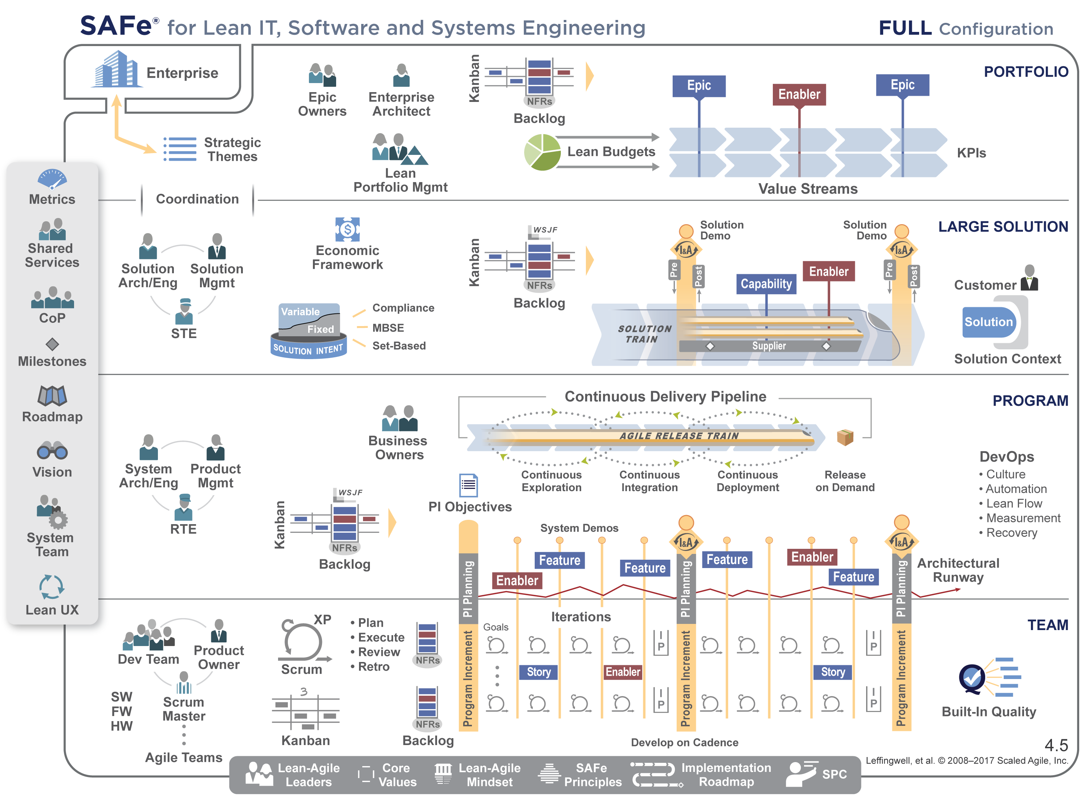
The Scaled Agile Framework SAFe 4.0
Synchronizes alignment, collaboration, and delivery for large numbers of teams
Core Values
Built-In Quality
Program execution
Alignment
Transparency
Notes:
The Core Values that we treasure and base the framework on are unchanged:
With its built-in-quality focus, SAFe helps teams create good code and components quality, which is important, because “You can’t scale crappy code” (or hardware or anything else).
There is a primary focus on program execution, which is the ability to build large systems incrementally, in a predictable and reliable manner. If you can’t do that, not much else really matters.
Global alignment trumps local optimization. Everyone needs to understand and agree on what it is they are building, and what problems the system needs to address. Teams are empowered, for certain, but they work together to accomplish the larger program and enterprise mission.
Lean and Agile require trust to be effective. The framework helps build trust via transparency. Lean doesn’t work if an organization hides behind its politics, because “you can’t manage a secret.”

Slide 12
SAFe Core Values
Built-In Quality – Quality comes first, but not in the last “You can’t scale crappy code”
Program Execution – ability to build large systems incrementally, in a predictable and reliable manner.
Alignment – Teams are empowered, for certain, but they work together to accomplish the larger program and enterprise mission.
Transparency – build trust via transparency, you can’t manage a secret
Notes:
The Core Values that we treasure and base the framework on are unchanged:
With its built-in-quality focus, SAFe helps teams create good code and components quality, which is important, because “You can’t scale crappy code” (or hardware or anything else).
There is a primary focus on program execution, which is the ability to build large systems incrementally, in a predictable and reliable manner. If you can’t do that, not much else really matters.
Global alignment trumps local optimization. Everyone needs to understand and agree on what it is they are building, and what problems the system needs to address. Teams are empowered, for certain, but they work together to accomplish the larger program and enterprise mission.
Lean and Agile require trust to be effective. The framework helps build trust via transparency. Lean doesn’t work if an organization hides behind its politics, because “you can’t manage a secret.”

Slide 13
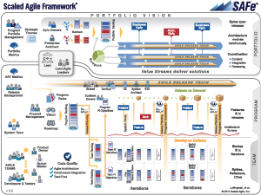
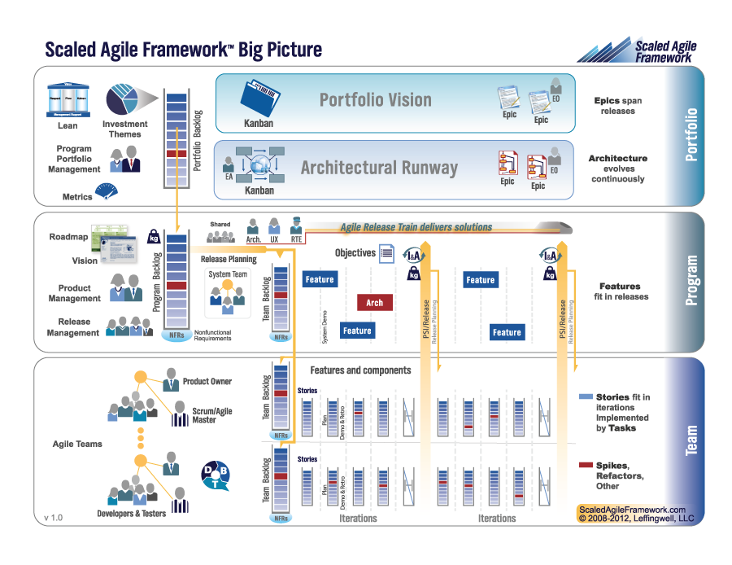
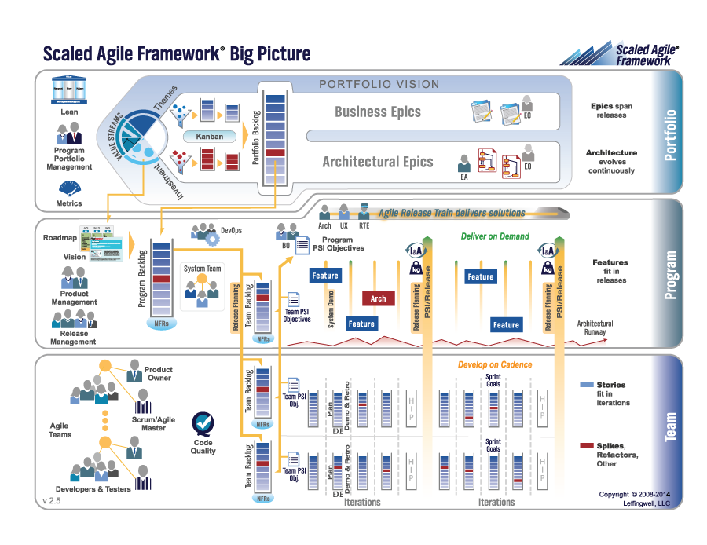
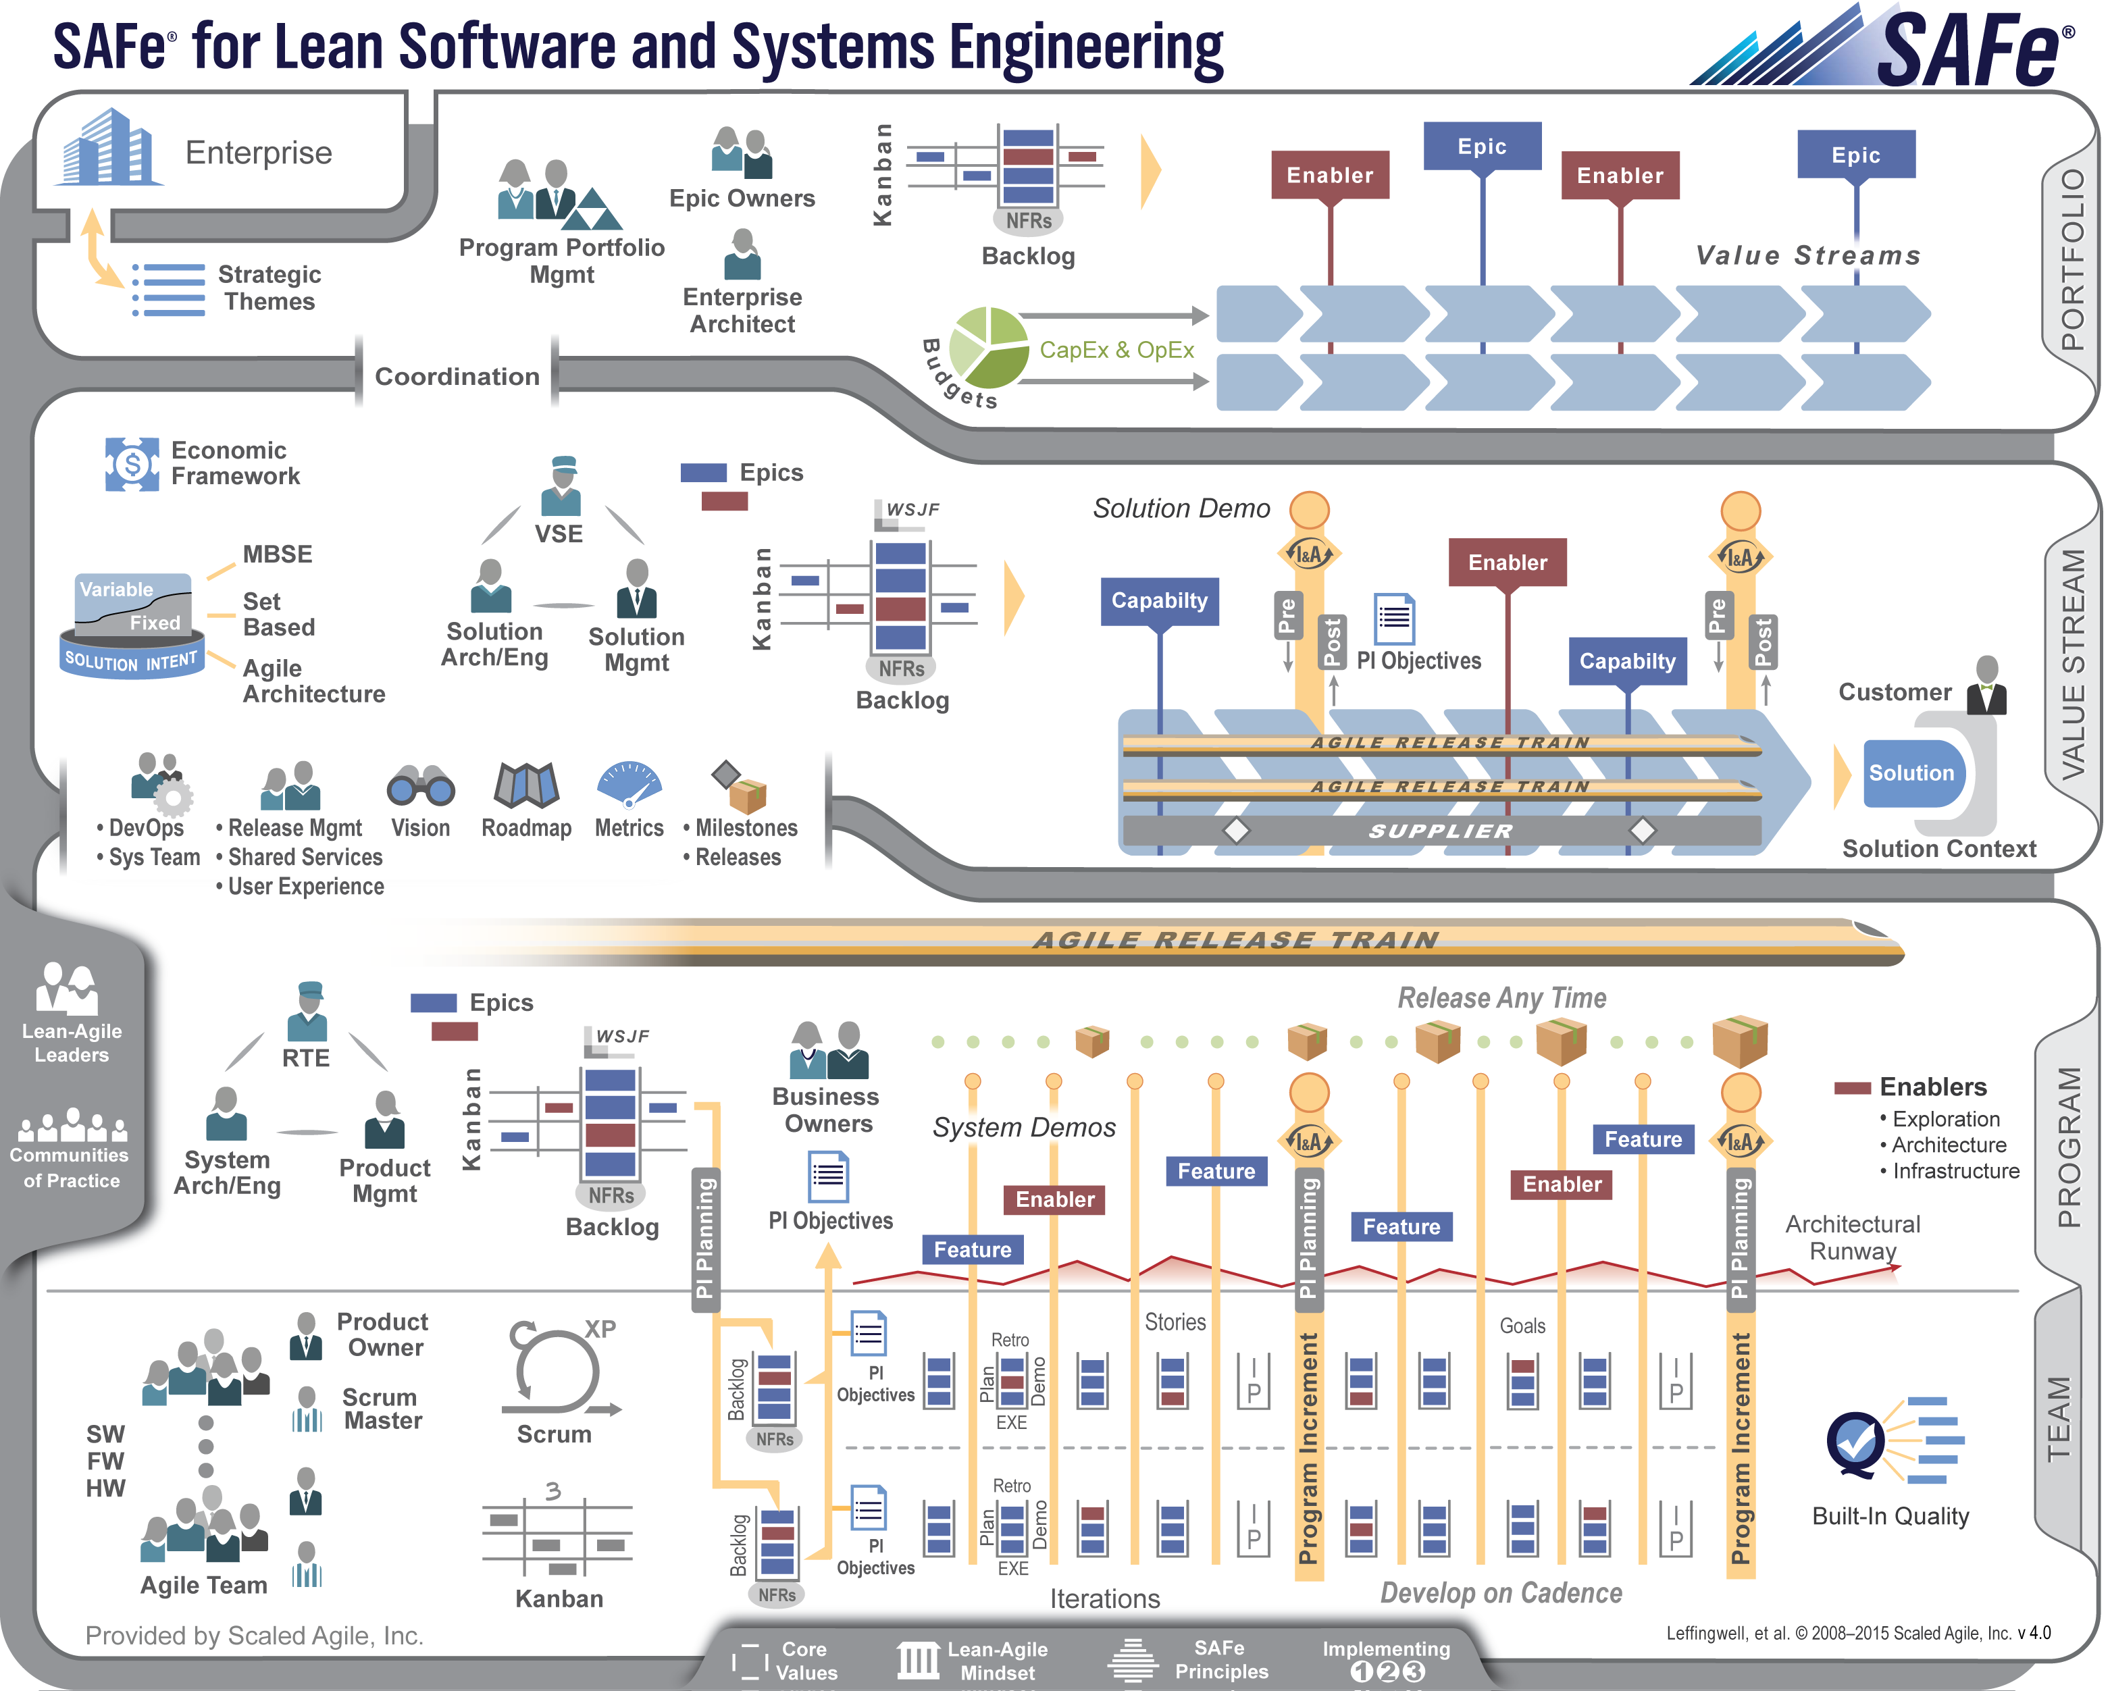
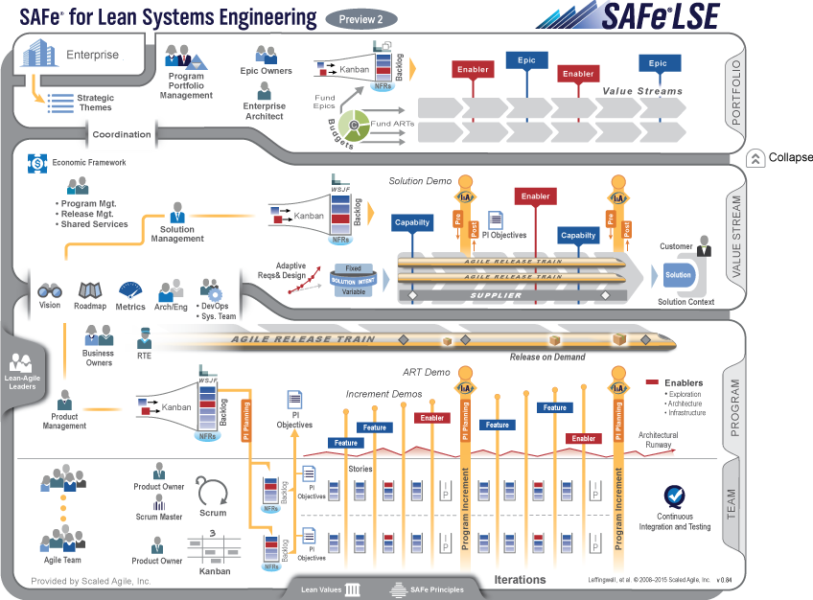
Roots, pasts, present and future
Field experience at enterprise scale
2011
Now…
3.0
4.0
4.5
1.0
2.0
LSE
Agile development | Lean product development | Systems thinking
Notes:
The Framework is based on a set of disparate but compatible bodies of knowledge – Agile development, Lean thinking and Lean product development, systems thinking, and systems engineering.
The knowledge of the Framework isn’t a one-time learning event…. It’s an ongoing process.
The first public release of SAFe, in its current web-accessible form, was in 2011. But its history goes back even earlier than that. So you can see that the pace of innovation is relentless and constant; we are always updating the site and its corresponding courseware with what we learn.
Articles can be updated and republished at any time. Previously we’d release more frequent updates to the “Big Picture” itself, but now there is about a once-a-year release cycle on the BP. We make an effort to be backwards compatible wherever possible, so the specific practices and roles you’ve adopted can remain largely unchanged while you avail yourself of the new features in each new release. “Behind the BP,” the pace of innovation continues, as we are continuously updating new articles and adding guidance articles as well.
With SAFe 4.0, we have merged the practices of SAFe for Lean Systems Engineering and SAFe 3.0 into a new release. As such, SAFe 4.0 handles the needs of small to medium-size software and systems builders, but it also scales to the needs of those building some of the world’s biggest, most complex, and most impactful software solutions and cyber-physical systems.
Let’s look further into this major new release.

Slide 14
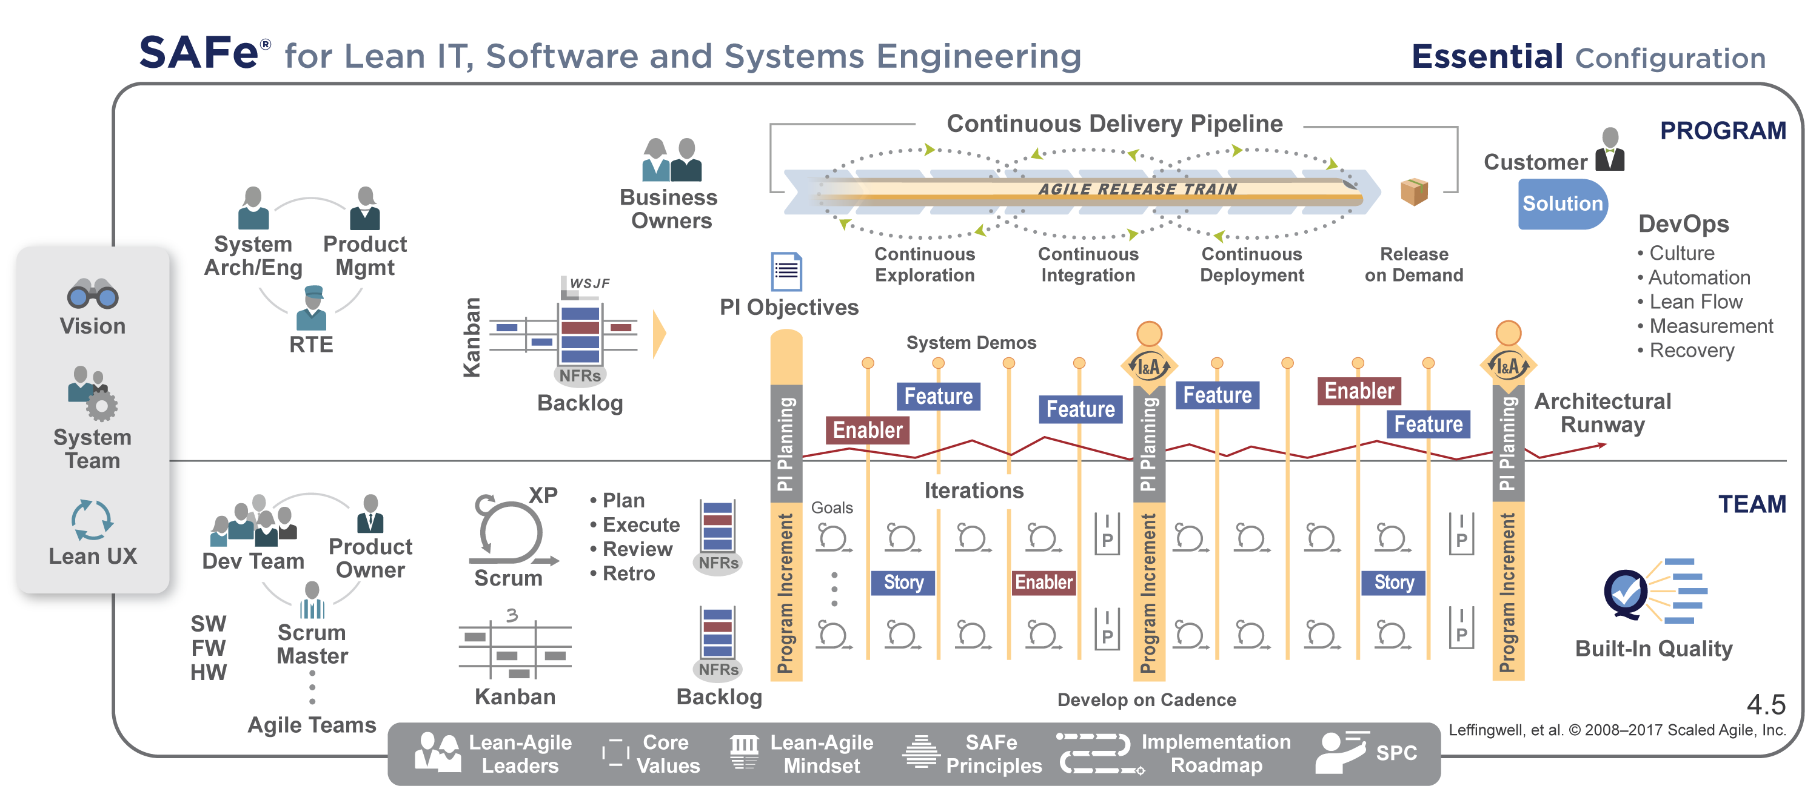
Essential SAFe provides the basis for success

Slide 15
Nothing beats an agile team
Empowered, self-organizing, self-managing, cross-functional team
Delivers valuable, tested, working system every two weeks
Uses a team framework which combines the best of Scrum project management, XP-inspired technical practices and Kanban for flow
Value delivery via User Stories
Notes:
The Team Level has been updated, too.
SAFe now supports Kanban for teams, with the team’s local Kanban feeding the Team Backlog.
Scrum is directly supported and described, as has always been the case.
We’ve also selectively harvested and described some XP practices: collective ownership, Continuous Integration, Test-First, pair work (not necessarily pair programming).
Calling out these elements of Scrum, Kanban, and XP enables teams to apply the best of all of them, and ignore the external method wars.
Built-In Quality guidance has been expanded to cover software and hardware.

Slide 16
Except a team of agile team
Self-Organizing, Self-Managing team of agile teams
Delivers valuable, tested, working system every two weeks
Operates with vision, architecture and UX guidance
Common Iteration lengths and estimating
Face-to-Face planning for collaboration, alignment and adaptation
Notes:
The Team Level has been updated, too.
SAFe now supports Kanban for teams, with the team’s local Kanban feeding the Team Backlog.
Scrum is directly supported and described, as has always been the case.
We’ve also selectively harvested and described some XP practices: collective ownership, Continuous Integration, Test-First, pair work (not necessarily pair programming).
Calling out these elements of Scrum, Kanban, and XP enables teams to apply the best of all of them, and ignore the external method wars.
Built-In Quality guidance has been expanded to cover software and hardware.

Slide 17
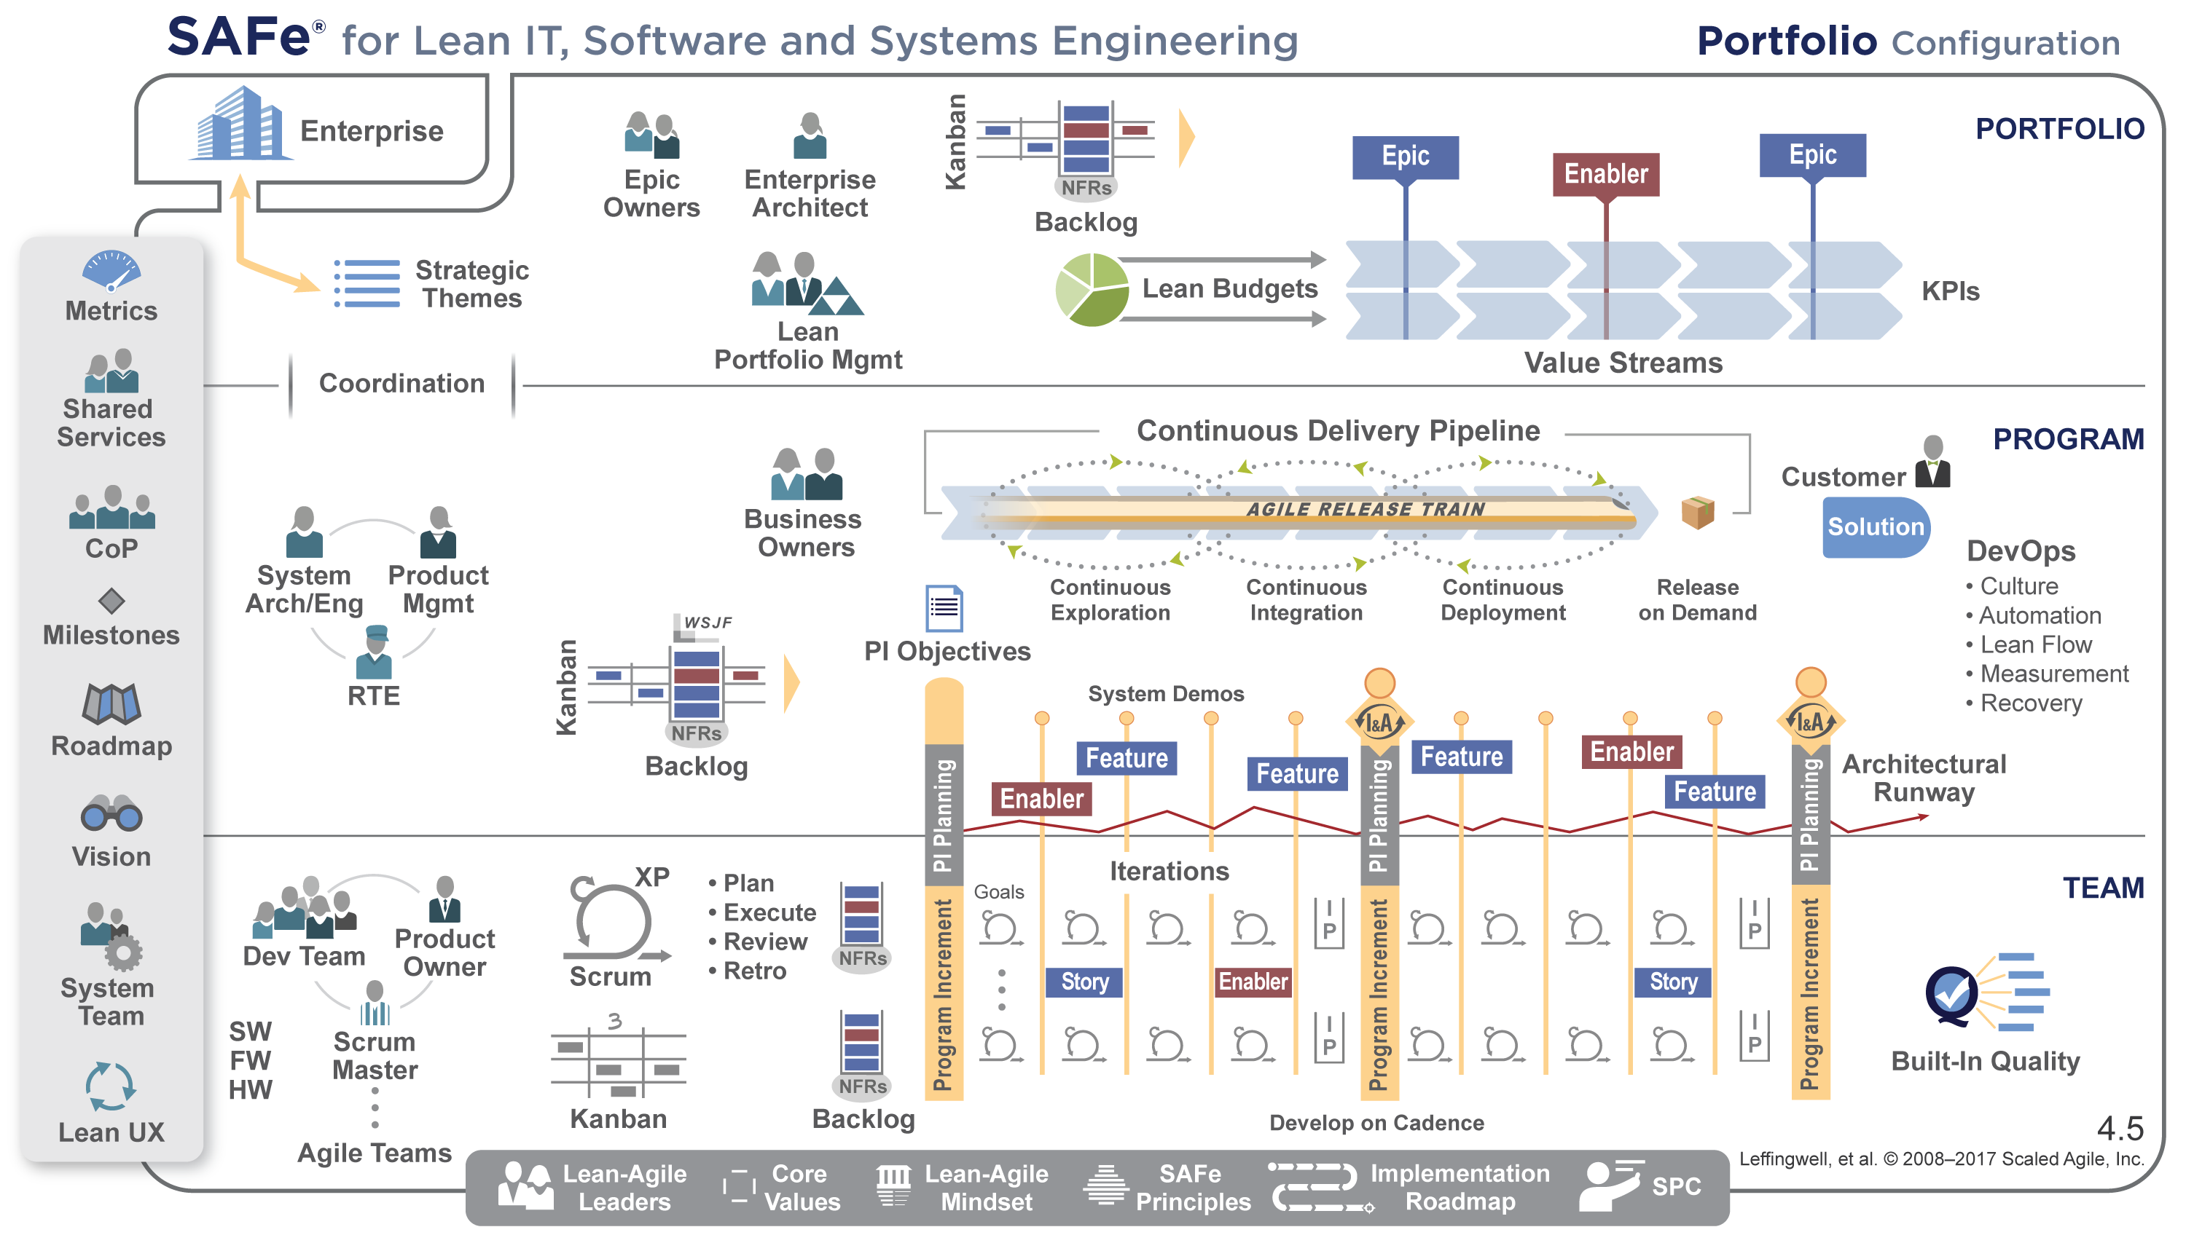
Portfolio SAFe aligns strategy and execution
Notes:
Organized around the flow of value
Lean-Agile budgeting empowers decision makers
Kanban system provides portfolio visibility and WIP limits
Enterprise architecture guides larger technology decisions
Objective metrics support governance and improvement
Value delivery via Epics

Slide 18
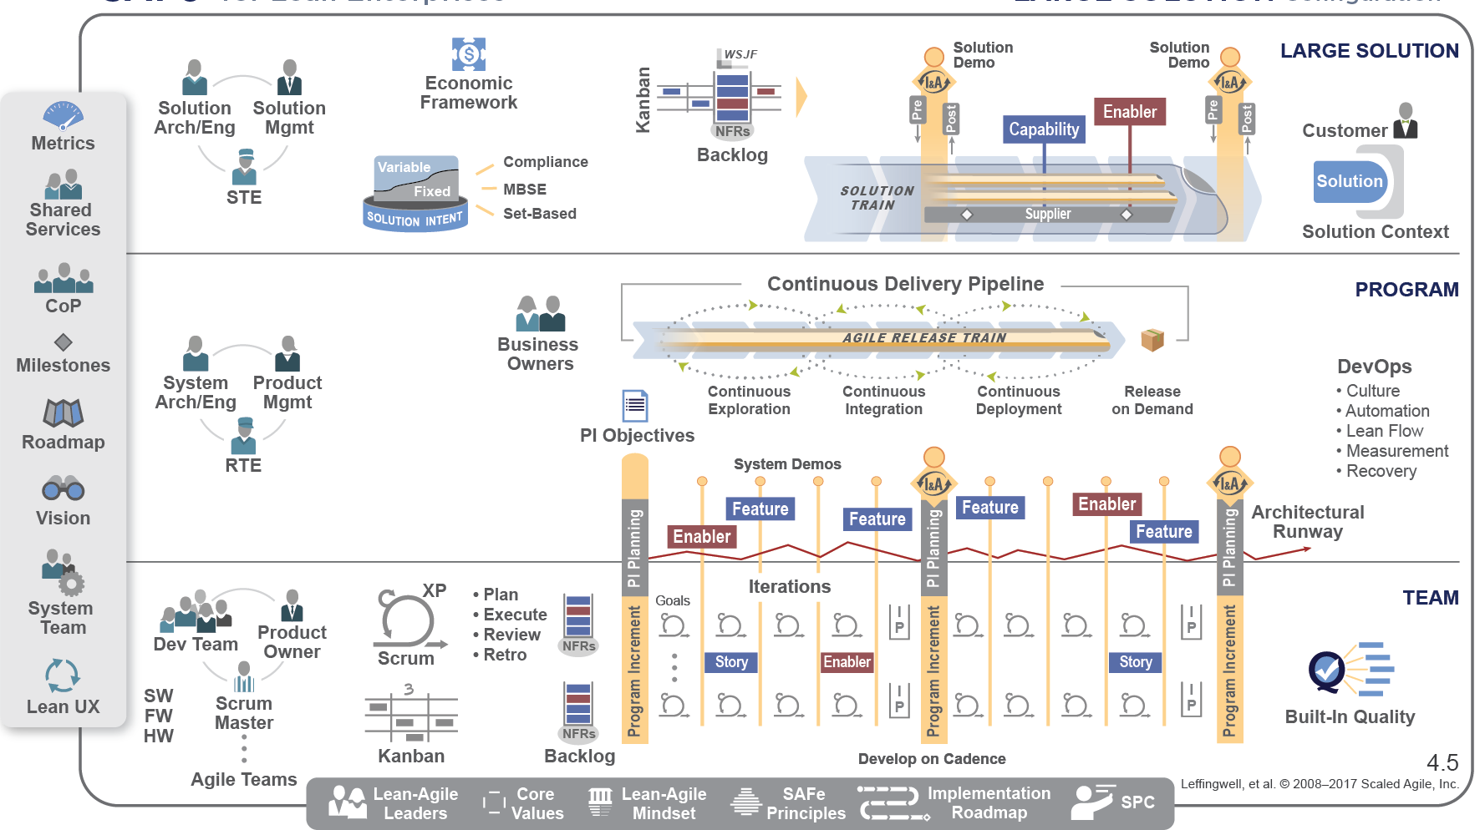
Large Solution SAFe coordinates ARTs with a Solution Train
Notes:
Coordinates development of large Solutions
Synchronizes multiple ART Value Streams
Manages Solution Intent
Integrates suppliers as partners
Value delivery via Capabilities

Slide 19
Full SAFe for large enterprises

Slide 20
Business results
10 – 50% happier, more motivated employees
30 – 75% faster time-to-market
ENGAGEMENT
TIME-TO-MARKET
PRODUCTIVITY
BUSINESS RESULTS
QUALITY
20 – 50% increase in productivity
25 – 75% defect reduction
See ScaledAgileFramework.com/case-studies
Notes:
You'll get results like these:
Happier, more motivated employees
30 to 75% faster time to market
50%-plus defect reduction, and a
20 to 50% increase in productivity.
These are some pretty impressive results results and may sound like something that’s tough to believe or marketing hyperbole…..

Slide 21
1.2 Explore the Lean, the Agile Manifesto and SAFe Principles
Notes:
First, let's discuss embracing a Lean-Agile mindset.

Slide 22
Embrace Lean-Agile values
SAFe House of Lean
Agile Manifesto
VALUE
We are uncovering better ways of developing software by doing it and helping others do it. Through this work we have come to value:
Individuals and interactions over processes and tools
Working software over comprehensive documentation
Customer collaboration over contract negotiation
Responding to change over following a plan
Respect for
people and culture
Relentless
improvement
Flow
Innovation
LEADERSHIP
Value in the shortest
sustainable lead time
That is, while there is value in the items on the right, we value the items on the left more.
Notes:
Our Lean-Agile mindset is represented in two things:
(1) The House of Lean, which you see here. It has a number of elements:
Value, because the goal of Lean is very simple: value, and the shortest sustainable lead time.
That's accomplished by the pillars of respect for people and culture, product development flow, innovation—critical to long-term sustainability—and relentless improvement.
And it's supported by leadership.
That's the structure in which we tend to think about the Lean paradigm.
---
(2) Secondly is the Agile Manifesto, which has been with us now since 2001 It's a very well-written document, and what it says is still true today. We need the Agile Manifesto because it's the key to unlocking the motivations and the talents of the knowledge workers who develop our solutions and software.
And it states specifically, "Individuals and interactions over processes and tools." Because talking matters.
"Working software over comprehensive documentation."
"Customer collaboration over contract negotiation."
And "Responding to change over following a plan."

Slide 23
Agile Manifesto
Meeting at Snowbird resort by 17 software pundits and light weight methodologists, February 2001. Created “Agile Manifesto”
We are uncovering better ways of developing software by doing it and helping others do it. Through this work we have come to value. i.e., Agile Values
Individuals and interactions over processes and tools
Working software over comprehensive documentation
Customer collaboration over contract negotiation
Responding to change over following a plan
That is, while there is value in the items on the right, we value the items on the left more.
Author:- Kent Beck, Mike Beedle, Arie Van Bennekum, Alistair Cockburn, Ward Cunningham, Martin Fowler, James Greening, Jim Highsmith, Andrew Hunt, Ron Jerries, Jon Kern, Brian Marick, Robert C. Martin, Steve Mellor, Ken Schwaber, Jeff Sutherland, Dave Thomas

Slide 24
Individual and interaction over process & Tools
Individuals and interactions are most important
Processes and tools will be needed on projects
Projects are completed by people not processes and tools
Agile projects are people driven

Slide 25
Working Software over Comprehensive Documentation
Agile project need to deliver value
Value is about the purpose or business need the project aims to deliver
Documentation is barely sufficient
Documentation is done just in time –as the last responsible moment
Documentation might also be just because
Industry requirements
Organizational requirements

Slide 26
Customer Collaboration Over Contract negotiation
Agile is flexible, accommodating, and willing to change
Contracts are often rigid and uncooperative
Agile contracts must accommodate change
There’s a difference between being right and doing the right thing

Slide 27
Responding to change over following a plan
Agile welcomes change
Predictive projects plan everything in advance
Agile projects have lots and lots of many changes
Agile projects have uncertainty up front

Slide 28
12 Principles behind Agile Manifesto
No | Principle | Shortened Version
1 | Our highest priority is to satisfy the customers through early and continuous delivery of valuable software | Customer Satisfaction
2 | Welcome changing requirements, even late in development. Agile processes harness change for the customer's competitive advantage. | Welcome Changes
3 | Deliver working software frequently, from a couple of weeks to a couple of months, with a preference to the shorter timescale. | Deliver Frequently
4 | Business people and developers must work together daily throughout the project. | Work with business
5 | Build projects around motivated individuals. Give them the environment and support they need, and trust them to get the job done | Motivated People
6 | The most efficient and effective method of conveying information to and within a development team is face-to-face conversation. | Face to Face Communication

Slide 29
12 Principles behind Agile Manifesto
No | Principle | Shortened Version
7 | Working software is the primary measure of progress. | Measure Software Done
8 | Agile processes promote sustainable development. The sponsors, developers, and users should be able to maintain a constant pace indefinitely. | Maintain Sustainable Pace
9 | Continuous attention to technical excellence and good design enhances agility. | Maintain Design
10 | Simplicity –the art of maximizing the amount of work not done is essential | Keep it Simple
11 | The best architectures, requirements, and designs emerge from self-organizing teams. | Team creates Architecture
12 | At regular intervals, the team reflects on how to become more effective, then tunes and adjusts its behavior accordingly. | Reflect and Adjust

Slide 30
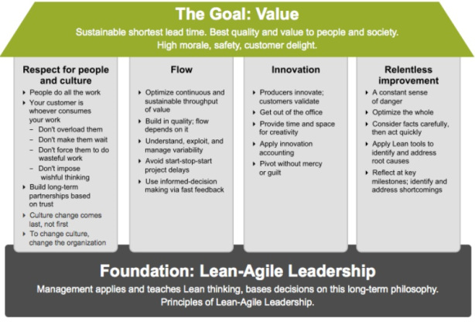
SAFe House of Lean in Nutshell
Notes:
The Framework is based on a set of disparate but compatible bodies of knowledge – Agile development, Lean thinking and Lean product development, systems thinking, and systems engineering.
The knowledge of the Framework isn’t a one-time learning event…. It’s an ongoing process.
The first public release of SAFe, in its current web-accessible form, was in 2011. But its history goes back even earlier than that. So you can see that the pace of innovation is relentless and constant; we are always updating the site and its corresponding courseware with what we learn.
Articles can be updated and republished at any time. Previously we’d release more frequent updates to the “Big Picture” itself, but now there is about a once-a-year release cycle on the BP. We make an effort to be backwards compatible wherever possible, so the specific practices and roles you’ve adopted can remain largely unchanged while you avail yourself of the new features in each new release. “Behind the BP,” the pace of innovation continues, as we are continuously updating new articles and adding guidance articles as well.
With SAFe 4.0, we have merged the practices of SAFe for Lean Systems Engineering and SAFe 3.0 into a new release. As such, SAFe 4.0 handles the needs of small to medium-size software and systems builders, but it also scales to the needs of those building some of the world’s biggest, most complex, and most impactful software solutions and cyber-physical systems.
Let’s look further into this major new release.

Slide 31
Leadership foundation
VALUE
Respect for
people and culture
Relentless
improvement
Flow
Innovation
LEADERSHIP
People are already doing their best; the problems are with the system. Only management can change the system.
—W. Edwards Deming
Notes:
Earlier we saw House of Lean and its Leadership foundation. And we talked about the inspiration that Deming has provided us.
I think this is another inspirational Deming quote: "People are already doing their best; the problems are with the system. Only management can change the system.”
What does that tell us?
It says that we've hired good people, we've motivated good people. The problems they're encountering in the workplace are systematic [systemic?] problems. They're problems with the system they're working in. And that means that it's up to management to take responsibility for evolving those systems.
We need you to lead the change. We need you to lead the implementation.

Slide 32
Agile Turns development Upside-down
Note: Difference between Waterfall and Agile

Slide 33
SAFe Lean-Agile principles
#1 - Take an economic view
#2 - Apply systems thinking
#3 - Assume variability; preserve options
#4 - Build incrementally with fast, integrated learning cycles
#5 - Base milestones on objective evaluation of working systems
#6 - Visualize and limit WIP, reduce batch sizes, and manage queue lengths
#7 - Apply cadence, synchronize with cross-domain planning
#8 - Unlock the intrinsic motivation of knowledge workers
#9 - Decentralize decision-making
Notes:
So let's discuss the Lean-Agile principles that underlie SAFe.
[Read through each of the principles on the slide]
We don't have time in presentation to drill into each of these, but if you head down the SAFe journey, it will be important to learn why these principles are so critical to a successful implementation of SAFe.
They are so important because principles trump practices.
So if we're struggling with a practice, we're going to return to these basic principles to make sure that we're trying to build a system and an implementation that is as Lean and Agile as possible.

Slide 34
#1 Take an economic view

Slide 35

Building incrementally accelerates value delivery
Requirements
Design
Implementation
WATERFALL
Verification
4
444
:
Documents
Documents
Unverified System
System
Incremental
Delivery
Notes:
On the previous slide, we said that Number 1 was to take an economic view.
Here's a first look at the economics of Agile development. Specifically: Building incrementally accelerates value delivery.
Traditionally, we looked at things as a series of steps. Our traditional waterfall life cycle had us doing what made sense: We did our requirements, our design, our implementation, and our verification—in that order. It's hard to argue with that; you couldn't do the implementation before you did the requirements, for example.
But we've learned a few things in the last couple of decades, and we now understand that it's possible—with the right constructs, the right thinking, and the right culture—to develop and deliver incrementally….
…. that's the basic nature of Agile and Lean development, as compared to our traditional development models.

Slide 36
And delivers better economics
Early delivery provides fast value with fast feedback
Fast feedback
Waterfall
Value Delivery
Incremental
Time
Notes:
The result is much better outcomes because each incremental delivery produces some value very early.
Notice that it's very early compared to waterfall, where even if we execute perfectly we're not getting any value till the end.
But that little box doesn't go away; it stays. It delivers value throughout the time. And if you think about it, this is the integral value of all the value we've delivered to our customer before we even reach what would have been the waterfall deadline.
That's a pretty compelling case. It means that even if you executed waterfall perfectly—and that's pretty hard to do—you still can't compete with the better economics of Agile development.
-------
[Note: On this slide, it is helpful to illustrate this concept if possible by walking through and drawing on each box… watch the companion Foundations video at www.ScaledAgileFramework.com to see Dean Leffingwell walk illustrate the benefits of incremental delivery with this slide and annotations]

Slide 37
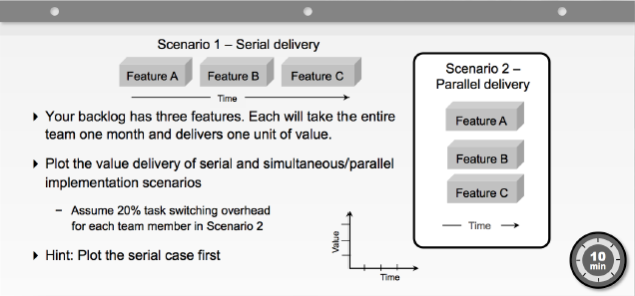
Exercise: Accelerating value delivery
Notes:
The Framework is based on a set of disparate but compatible bodies of knowledge – Agile development, Lean thinking and Lean product development, systems thinking, and systems engineering.
The knowledge of the Framework isn’t a one-time learning event…. It’s an ongoing process.
The first public release of SAFe, in its current web-accessible form, was in 2011. But its history goes back even earlier than that. So you can see that the pace of innovation is relentless and constant; we are always updating the site and its corresponding courseware with what we learn.
Articles can be updated and republished at any time. Previously we’d release more frequent updates to the “Big Picture” itself, but now there is about a once-a-year release cycle on the BP. We make an effort to be backwards compatible wherever possible, so the specific practices and roles you’ve adopted can remain largely unchanged while you avail yourself of the new features in each new release. “Behind the BP,” the pace of innovation continues, as we are continuously updating new articles and adding guidance articles as well.
With SAFe 4.0, we have merged the practices of SAFe for Lean Systems Engineering and SAFe 3.0 into a new release. As such, SAFe 4.0 handles the needs of small to medium-size software and systems builders, but it also scales to the needs of those building some of the world’s biggest, most complex, and most impactful software solutions and cyber-physical systems.
Let’s look further into this major new release.

Slide 38
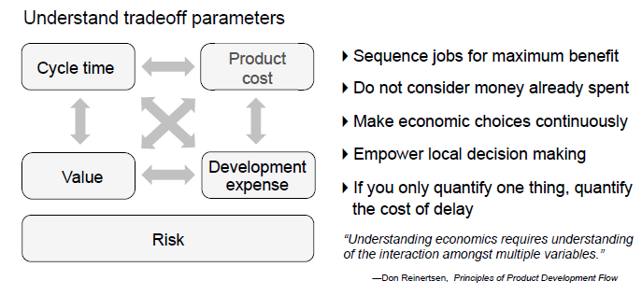
Base decisions on economics

Slide 39
#2 Apply Systems thinking

Slide 40
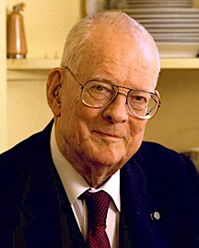
System Thinking
A system must be manager. It will not manage itself.
Left to themselves, components become selfish, independent profit centers and thus destroy the system..
The secret is co-operation between components toward the aim of the organization
—W. Edwards Deming

Slide 41
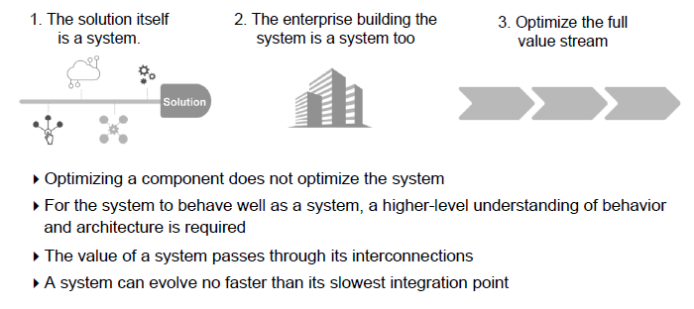
Aspects of System Thinking

Slide 42
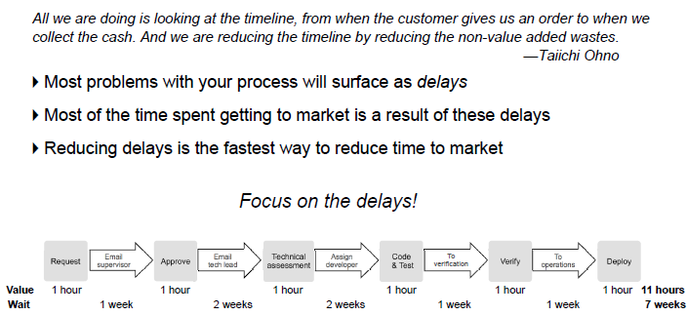
Optimize the full value stream

Slide 43
#3 Assume variability with fast, integrated learning cycles

Slide 44
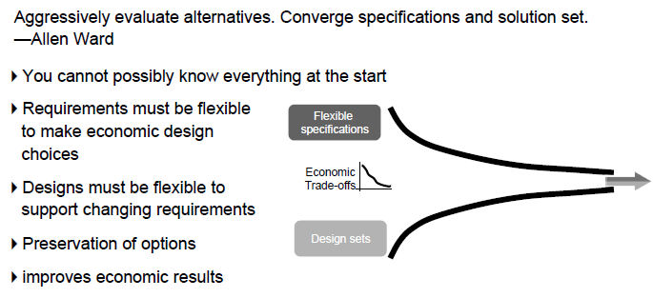
Development occurs in an uncertain world

Slide 45
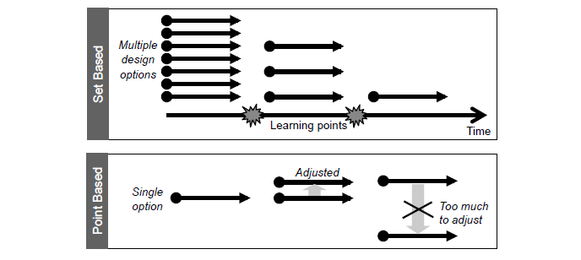
Apply a Set Based Approach

Slide 46
#4 Build incrementally with fast, integrated learning cycles

Slide 47
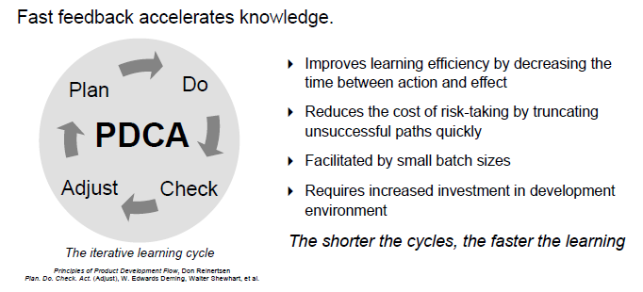
Apply fast learning cycles

Slide 48
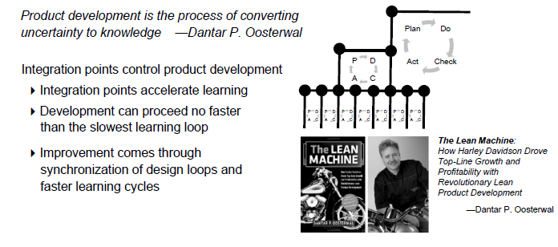
Apply fast learning cycles

Slide 49
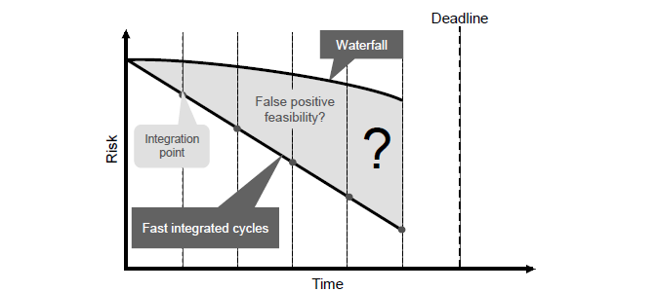
Integration points reduce risk

Slide 50
#5 Base milestones on objective evaluation of working systems

Slide 51
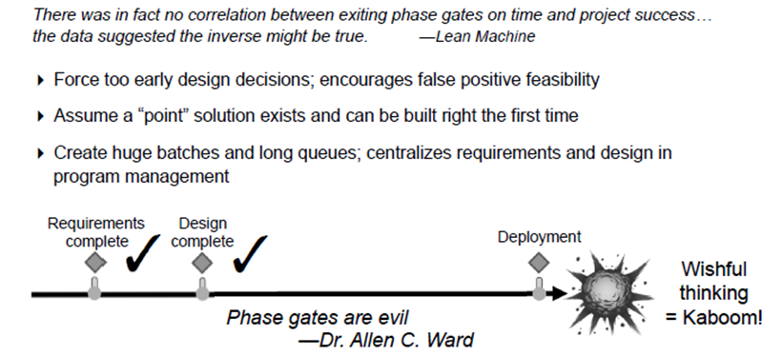
The problem of phase gate milestones

Slide 52
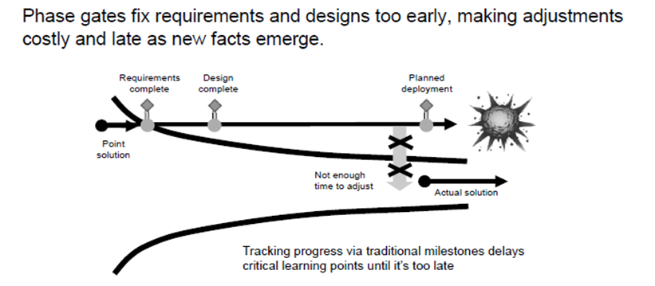
The problem of phase gate milestones

Slide 53
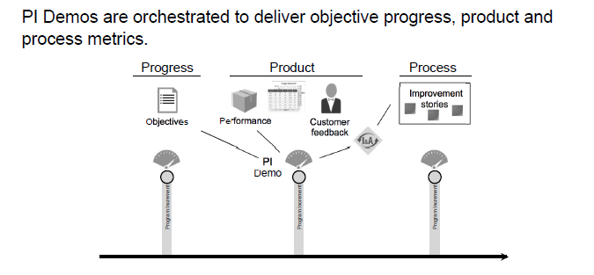
Apply objective milestones

Slide 54
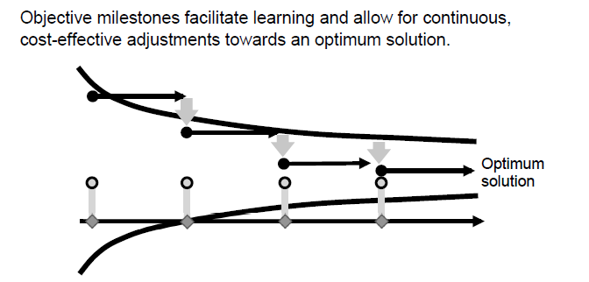
Iterate to the optimum solutions

Slide 55
#6 Visualize and limit WIP, reduce batch sizes, and manage queue lengths

Slide 56
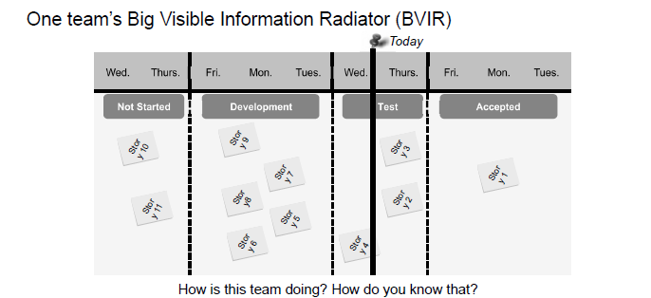
Visualize and limit work in progress

Slide 57
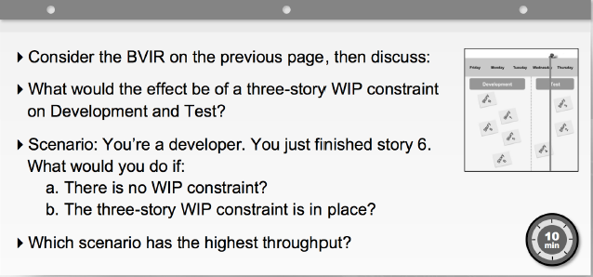
Exercise: Work in progress constraints

Slide 58
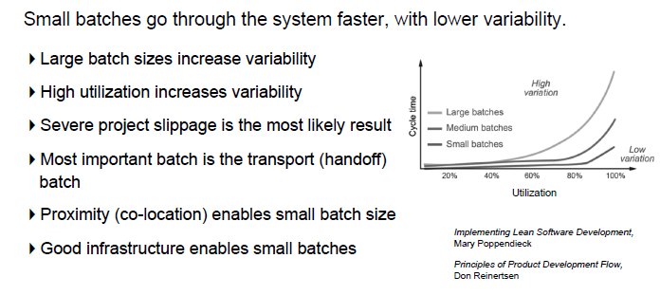
Reduce batch size

Slide 59
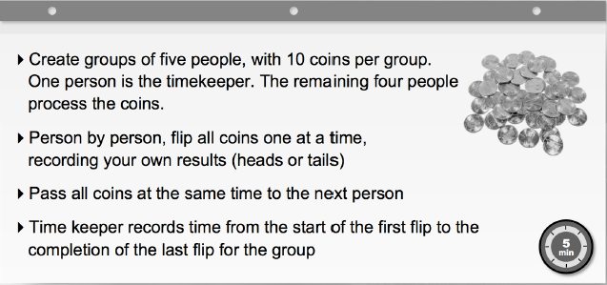
Exercise: Large batch push

Slide 60
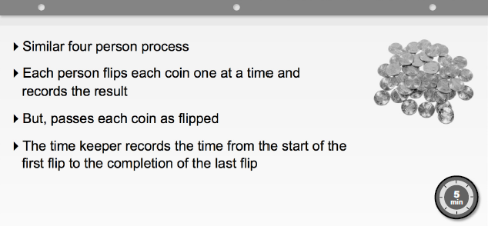
Exercise: Small batch pull

Slide 61
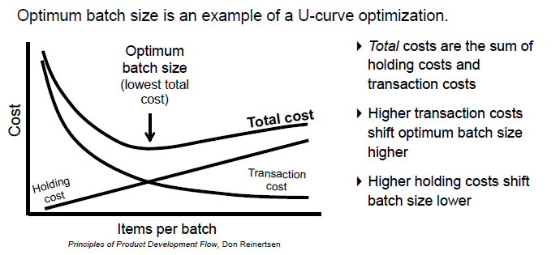
Finding optimum batch size

Slide 62
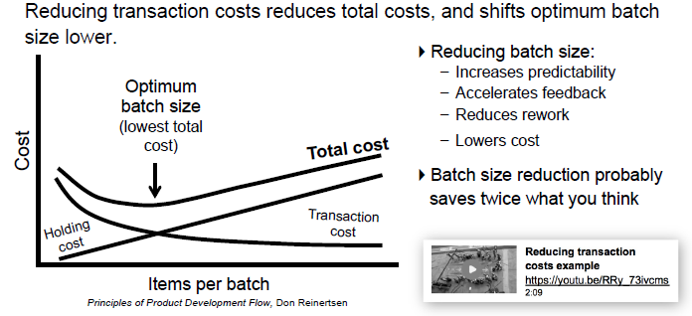
Reducing optimum batch size

Slide 63
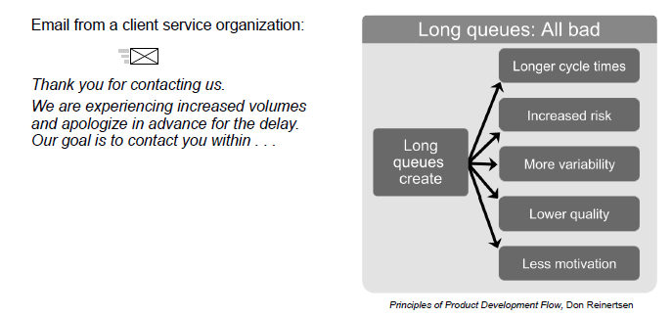
Manage queue lengths

Slide 64
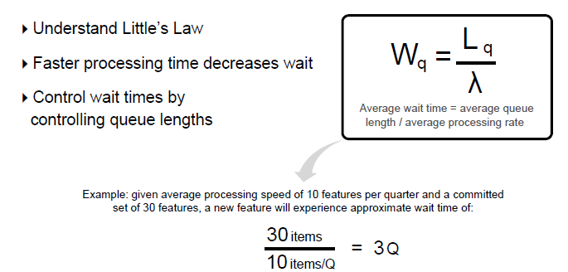
Reduce queue lengths

Slide 65
#7 Apply cadence, synchronize with cross-domain planning

Slide 66
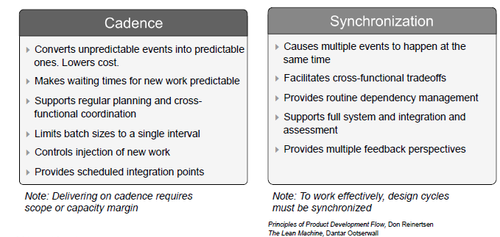
Cadence and Synchronization

Slide 67
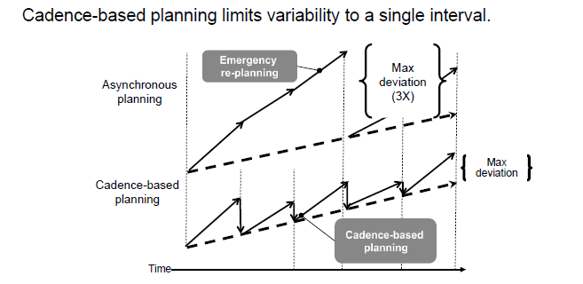
Control variability and planning cadence

Slide 68
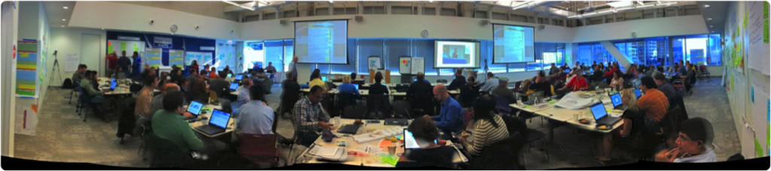
Synchronizes with cross domain Planning
Future product development tasks can’t be pre-determined. Distribute planning and control to those who can understand and react to the end results. — Michael Kennedy, Product Development for the Lean Enterprise
All stakeholders face-to-face (but typically multiple locations)
Management sets the mission, with minimum possible constraints
Requirements and design emerge
Important stakeholder decisions are accelerated
Teams create—and take responsibility for—plans
For a short video PI planning example, see: https://youtu.be/ZZAtl7nAB1M
Notes:
The ART synchronizes its work with PI Planning.
Michael Kennedy explained it as: "Future product development tasks can't be predetermined. Distribute planning and control to those who can understand and react to the end results."
Here you see a picture of a distributed planning session. There are actually three countries at work here. There's a large group in Mumbai, India; they're not present. There are a lot of folks from Chicago, and some leads and some managers from the teams in Serbia. They're all planning together over a two-day period.
Typically PI Planning is face to face, but, if it's a large organization, you may not be able to have everybody face to face every time.
Management sets the mission, with minimal possible constraints—that's a key philosophy of Lean Thinking.
Requirements and design emerge. We talk about emergent design as one of the key aspects of Agile, and it emerges here. We call this PI Planning, but there's far more than planning that happens. People collaborate, they determine new requirements, they negotiate teams and dependencies.
Business owners add features and take out features to manage scope. Important stakeholder decisions are accelerated in a day—not after six weeks of emails banging around, trying to find the right person to make the decision, but right now.
In this picture, one group of managers at a PI Planning had a sign that said, "Help Desk—we're here to help." That was a great underscored the important construct that if decisions need to be made, they could make those decisions.
Ultimately, teams create and take responsibility for the plans, and that's a big difference from our traditional command-and-control, centralized program-planning model. In this case, management sets the vision, but the teams create the plans.

Slide 69
#8 Unlock the intrinsic motivation of knowledge workers

Slide 70
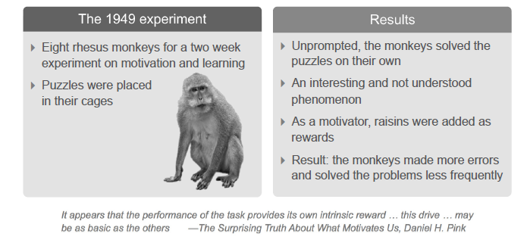
Drive: The puzzling puzzles of Harry Harlow

Slide 71
#9 Decentralize decision making

Slide 72
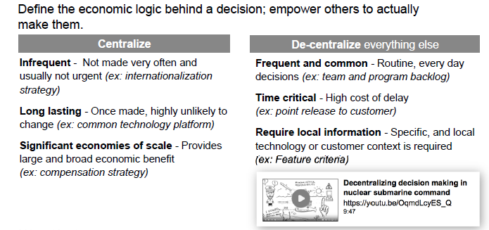
Decentralize decision-making

Slide 73
1.3 Identify Scrum, Kanban and XP Practices
Notes:
First, let's discuss embracing a Lean-Agile mindset.

Slide 74
From traditional development to Agile

Slide 75
Agile for Team: Scrum

Slide 76
Agile for Team: Kanban

Slide 77
Agile for Team: Kanban

Slide 78
Agile for Team: XP

Slide 79
Teams in SAFe are part of an Agile Release Train

Slide 80
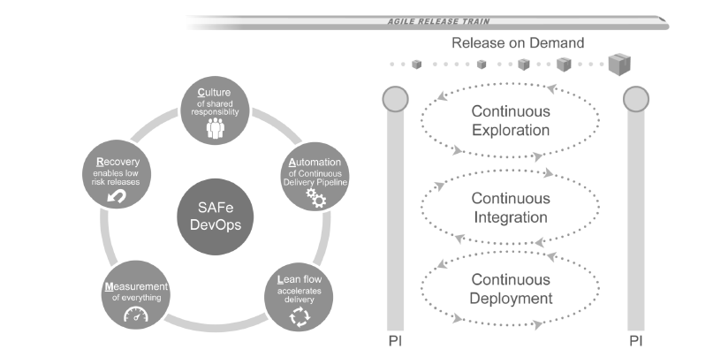
The Art and Teams continuously deliver value

Slide 81
Lesson Summary

Slide 82
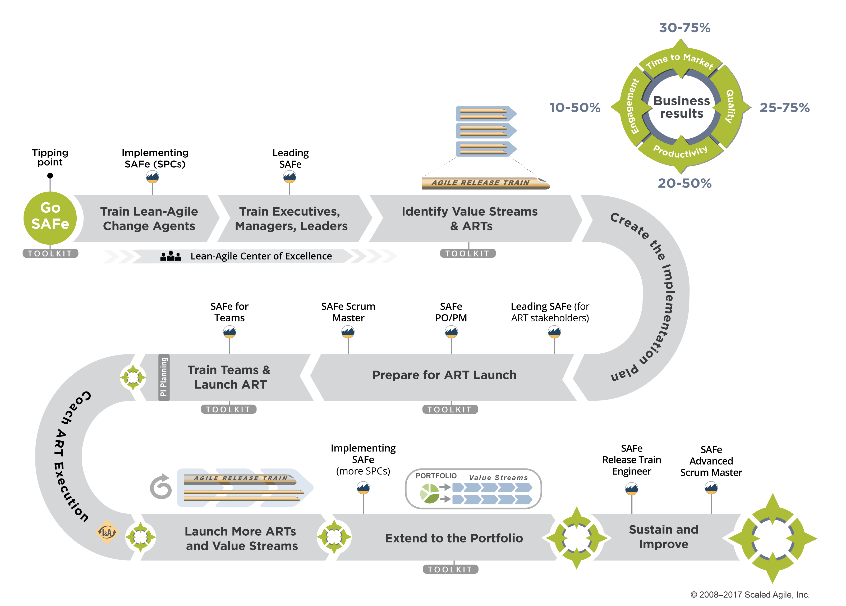
Implementation Roadmap - SAFe
Notes:
Finally, let's discuss implementation. We'll describe that using our Implementing SAFe 1-2-3 model.
Number 1 is to train the Lean-Agile change agents. We call those SAFe Program Consultants.
With a sufficient staff of Lean-Agile change agents onsite, and working with your partners, you'll have the ability to train the executives and leaders and managers—the people responsible for managing the people who deliver value.
They'll then be in a position to support the launch of the Agile Release Trains. And one train at a time, you'll build that Agile portfolio.

Slide 83
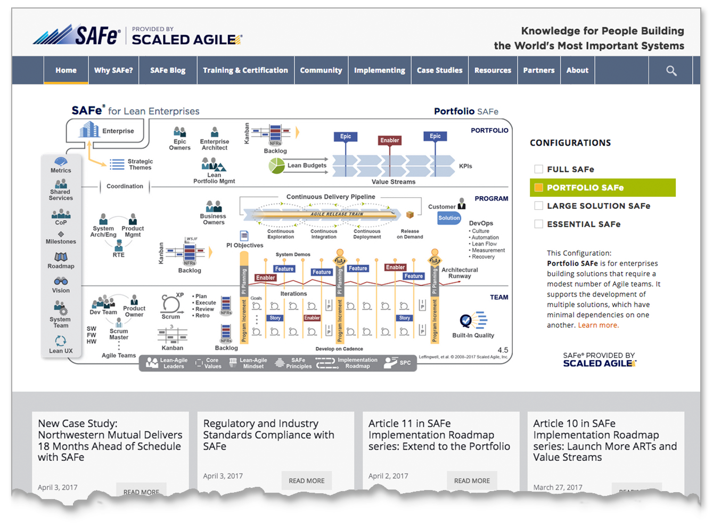
ScaledAgileFramework.com
Explore the SAFe knowledge base and find free resources:
Articles
Guidance
Presentations
White papers
Videos
Case studies

Slide 84
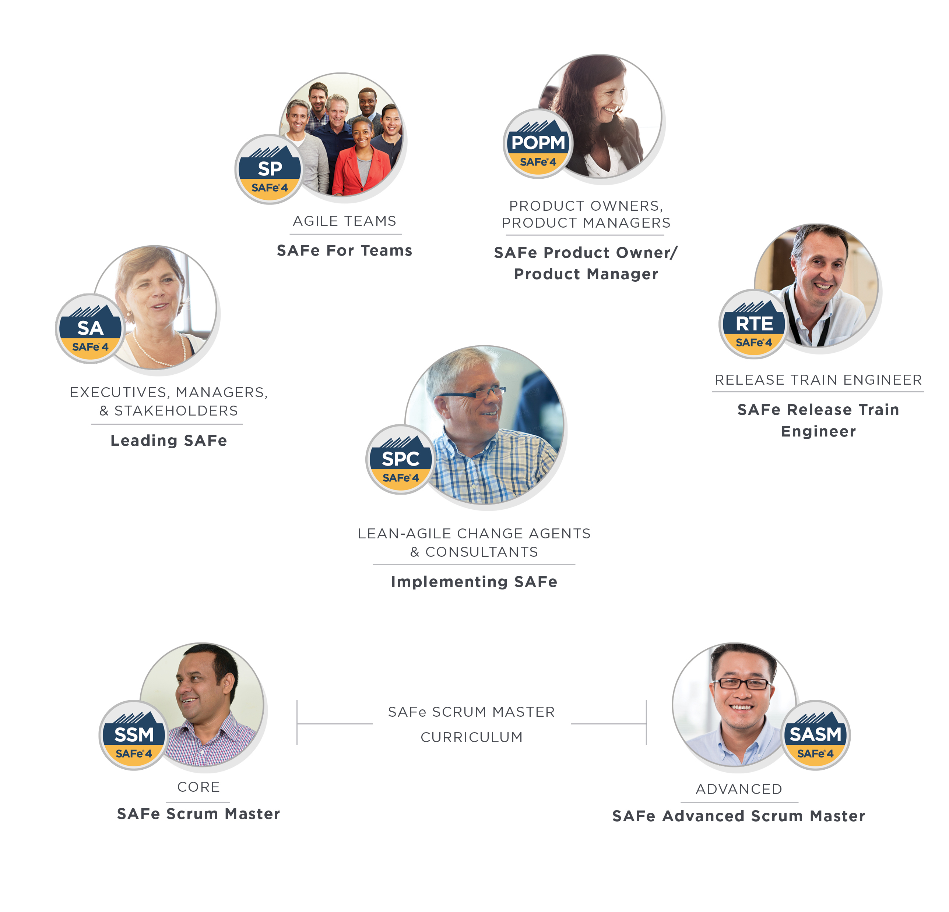
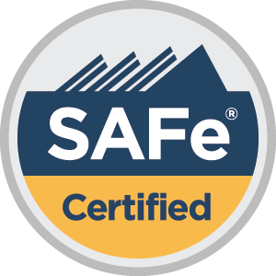
ScaledAgile.com
Find SAFe training worldwide
CORE
Leading SAFe
SAFe for Teams
SAFe Scrum Master
SAFe PO/PM
ADVANCED
SAFe Advanced Scrum Master
Implementing SAFe
SAFe Release Train Engineer
Notes:
Scaled Agile’s role-based curriculum helps enterprises unlock business results with SAFe.
Each course is designed to help individuals maximize the value of their role within a SAFe organization, and help them advance throughout their career as they practice, consult, or train others in SAFe.
The result is higher-quality implementations, and greater stability for the organization.

Slide 85

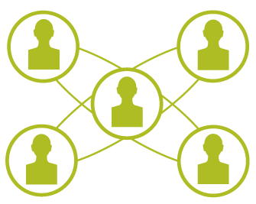
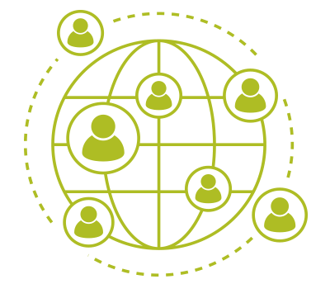

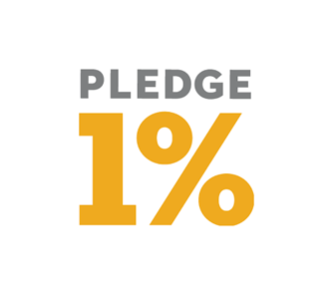


SAFe® for Lean Enterprises
130,000
130
SAFe is a framework of mindset, principles, and practices for scaling Lean-Agile development throughout the enterprise
Freely Available SAFe’s body of knowledge is freely available at scaledagileframework.com
SAFe certified
professionals
in 100+ countries
Scaled Agile Partners
in 35 countries
Configurable
SAFe is able to accommodate enterprises
of all sizes and industries
70%
US Fortune 100 enterprises have SAFe certified professionals
Fastest Growing Method 11th Annual State of Agile Survey by VersionOne
28% cite SAFe as preferred method for scaling Agile, making SAFe the most popular scaling method above Scrum and Scrum of Scrums
1.7 million
Pledged 1%
Scaled Agile stock equity & employee time to Pledge 1% campaign
Annual Gathering
Annual visitors to SAFe and Scaled Agile websites
28%

Slide 86
SAFe 4.5 Big Picture
Notes:
First, let's discuss embracing a Lean-Agile mindset.

Slide 87
Essential SAFe provides the basis for success

Slide 88
Portfolio SAFe aligns strategy and execution
Notes:
Organized around the flow of value
Lean-Agile budgeting empowers decision makers
Kanban system provides portfolio visibility and WIP limits
Enterprise architecture guides larger technology decisions
Objective metrics support governance and improvement
Value delivery via Epics

Slide 89
Large Solution SAFe coordinates ARTs with a Solution Train
Notes:
Coordinates development of large Solutions
Synchronizes multiple ART Value Streams
Manages Solution Intent
Integrates suppliers as partners
Value delivery via Capabilities

Slide 90
Full SAFe for large enterprises

